Slide 1
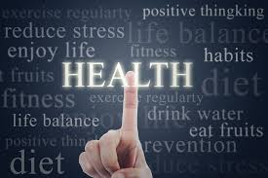
Chapter 6
Positive

Slide 2
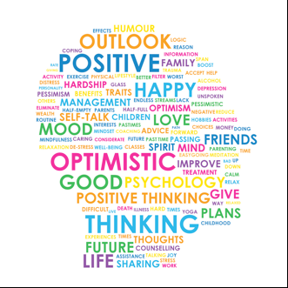
Positive Health
Health--a state of complete physical, mental, and social well-being
Theory: Imbalance of physical elements causes mental illness (e.g., Ancient Greeks and 4 humors; today neurotransmitters)
Physical health defined as the absence of illness
Healthy and vital physical body is important for mental health
Notes:
Psychological states have no link to physical health.

Slide 3
Positive Health
Wellness
Health is a state of physical, mental, and emotional health, not just absence of disease and infirmity (WHO, 1946)
Encompasses the benefits of overall growth
Notes:
Wellness is a state in which a person has:
1. a zest for life,
2. A way of living that maximized potential,
3. A sense of meaning and purpose,
4. A sense of social responsibility
5. Skills for adapting to the challenges of a changing environment.
Wellness encompasses the benefits of exercise, nutrition, stress management, emotional self-regulation, social support, and personal growth.

Slide 4
Positive Health
Wellness (Dunn)
Wellness is a state in which a person has:
1. A zest for life,
2. A way of living that maximizes potential,
3. A sense of meaning and purpose,
4. A sense of social responsibility
5. Skills for adapting to the challenges of a
changing environment.
Wellness encompasses the benefits of exercise, nutrition, stress management, emotional self-regulation, social support, and personal growth.
Notes:
Wellness is a state in which a person has:
1. a zest for life,
2. A way of living that maximized potential,
3. A sense of meaning and purpose,
4. A sense of social responsibility
5. Skills for adapting to the challenges of a changing environment.
Wellness encompasses the benefits of exercise, nutrition, stress management, emotional self-regulation, social support, and personal growth.

Slide 5
Positive Health
Positive Health: Absence of disease and Excellence in three measures:
Biological markers/Physiological (e.g., cardiac, pulmonary health)
Subjective experiences
e.g., optimism, energization, sense of vitality
Functional measures: how well daily activities are accomplished and behavioral signs (e.g., adjustment to normal aging)

Slide 6
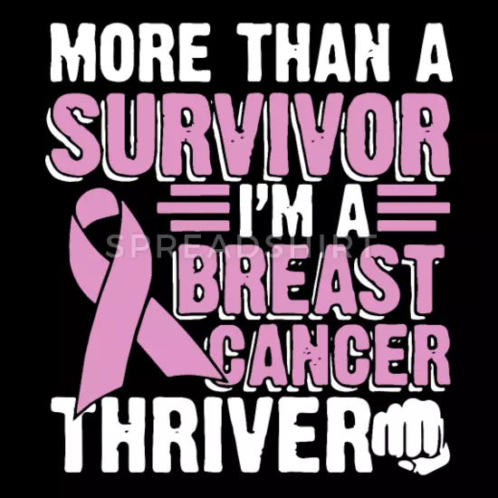
Positive Health
Goal of positive health is to describe adaptations to challenges and a better quality of life
Thriving: enhanced psychological and physical functioning after successful adaptations… better adaptations, more potent coping skills

Slide 7

Positive Health
Vitality
Positive feeling of aliveness and energy
Enhanced by activities that satisfy self-determination needs for competence, autonomy, relatedness
Factor in longevity
through its association
with autonomy

Slide 8

Positive Health
Exercise and Positive Health
Regular exercise healthy for both physical and psychological well-being
Personal accomplishment, self-efficacy, cognitive processes, fight off colds, self-acceptance, mindfulness; anxiety, depression, better sleep
Notes:
Other possible benefits of exercise may include a greater ability to fight off colds, better sleep, greater self-acceptance, and mindfulness.

Slide 9
Positive Health
Exercise and Positive Health
Vigorous physical activity better than moderate activity for lowering mortality rate
Overtraining a negative impact on well-being
Positive attitude toward exercise increases motivation to exercise
Notes:
Other possible benefits of exercise may include a greater ability to fight off colds, better sleep, greater self-acceptance, and mindfulness.

Slide 10
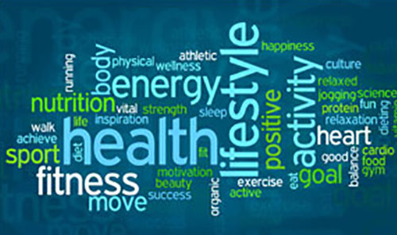
Positive Health
Health Psychology and PNI
Health psychology examines all factors that affect a person’s health
Psychoneuroimmunology (PNI) examines the relationships between
psychological processes (esp. emotion)
functioning of the nervous system
body's immune system

Slide 11
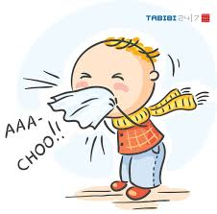
Positive Health
Health Psychology and PNI
Psychoneuroimmunology
Stress-common cold link with buffer of social network (lower social support 4x more likely to become ill)

Slide 12
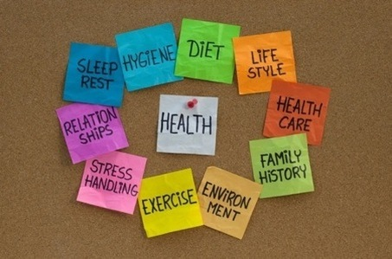
Psychological Factors Important to Health
Focus of this section is on how psychological factors can improve health status
Notes:
Number of cells related with immune functioning: One can either increase or decrease the number of cells in their own bodies related with immune functioning.

Slide 13

Psychological Factors Important to Health
Positive Emotionality
Positive people live longer than less happy people
Happier people have healthier functioning immune systems
Positive emotions promote positive health

Slide 14
Psychological Factors Important to Health
Positive Emotionality (remember Broaden and Build Theory)
Those with more frequent positive emotionality…
Perceived self as healthier (and objective measures confirmed it)
Showed more energy
Were more involved in enjoyable activities
Engaged in healthier behaviors
Had better coping skills
Had healthier immune systems

Slide 15
Psychological Factors Important to Health
Social Support
Cross etal (2018) “connections between social relationships and health are some of the strongest and most consistent psychological correlates of health in the medical literature” (p.6)
Includes:
Emotional support
Willingness of others to offer their time or other forms of tangible assistance

Slide 16
Psychological Factors Important to Health
Social Support helps increase:
compliance with medical treatments
reduce levels of medication
adoption of health-promoting behaviors
positive emotions

Slide 17
Psychological Factors Important to Health
Social Support
perceived closeness to one’s ethnic or racial group as well as a positive racial identity can serve to reduce health risks

Slide 18

Psychological Factors Important to Health
Social Support: Friendship and Confidant Relationships
Aristotle: Three types of friendship
Utility
Pleasure
Virtue (emotional concern and compassionate care)
Notes:
Three types of friendship:
Based on--
1. Utility: It is essentially business relations, based on mutual tangible benefits, such as money or power.
2. Pleasure: Friendships based on pleasure are predicated on fun interests, such as attending sporting events or concerts together.
3. Virtue: Friendship based on virtue has the greatest impact on human well-being in everyday life.

Slide 19
Psychological Factors Important to Health
Social Support: Friendship and Confidant Relationships
Adler: Presence of friends is important for child’s emotional well-being
Having a trusted friend lowers virtually all forms of risky and self-destructive behavior
People who have a confidant have better overall health
Show greater psychological resiliency and less vulnerability to depression
Notes:
Three types of friendship:
Based on--
1. Utility: It is essentially business relations, based on mutual tangible benefits, such as money or power.
2. Pleasure: Friendships based on pleasure are predicated on fun interests, such as attending sporting events or concerts together.
3. Virtue: Friendship based on virtue has the greatest impact on human well-being in everyday life.

Slide 20
Psychological Factors Important to Health
Social Support: Internet Use and Positive Relationships
Excessive time on Internet slightly decreases well-being
The impact of the Internet on well-being dependent on
Type of use
Time spent online
When people are online
Notes:
The impact of the Internet on well-being depends upon:
1. Type of use.
2. The time spent online.
3. When people are online.

Slide 21
Psychological Factors Important to Health
Social Support: Internet Use and Positive Relationships
Human need for a trusting bond strengthened by shared feelings seems timeless
Notes:
The impact of the Internet on well-being depends upon:
1. Type of use.
2. The time spent online.
3. When people are online.

Slide 22
Psychological Factors Important to Health
Social Support: Social Support and the Immune System
Social support brings measurable changes in the immune system
Loneliness can have negative effects on immune functioning
Loneliness can also have negative effects on psychological well-being

Slide 23

Psychological Factors Important to Health
Social Support: Social Support From Pets?
Pets enhances people’s health
Levels of oxytocin increase when people petted their dogs
People can gain health benefits by caring for a variety of pets

Slide 24

Psychological Factors Important to Health
Social Support: Restorative Nature Experiences
Nature affiliation evokes both pleasure and a deeper sense of meaning
Forest bathing allows mind to become clearer and sharper
Nature is not only restorative for people emotionally, but cognitively beneficial too

Slide 25
Psychological Factors Important to Health
Love and Positive Health
Married men benefit physiologically from marriage
Women need a good marriage to show increased health benefits

Slide 26
Psychological Factors Important to Health
Love and Positive Health: Touch
Associated with positive health
A caring touch releases oxytocin
Increases feelings of caring and empathy
Helps reduce pain and in treatment of psychological disorders
Reduces fatigue of leukemia patients
Helps people make better decisions

Slide 27
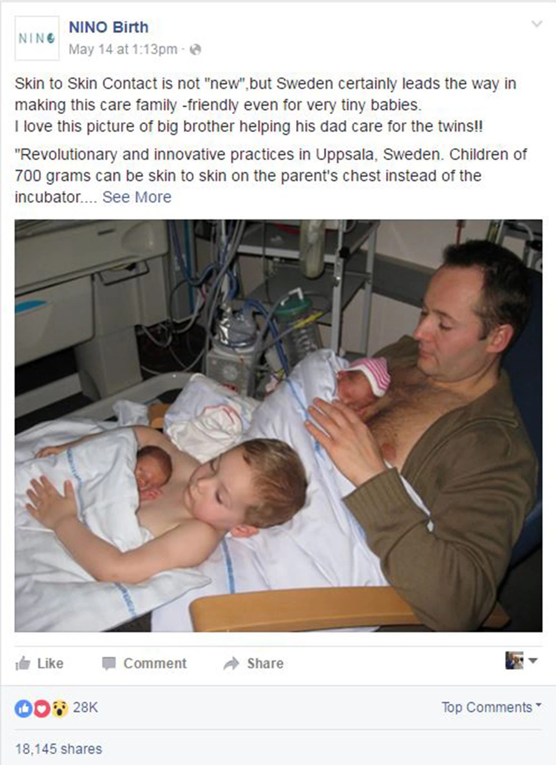
Psychological Factors Important to Health
Love and Positive Health: Touch

Slide 28
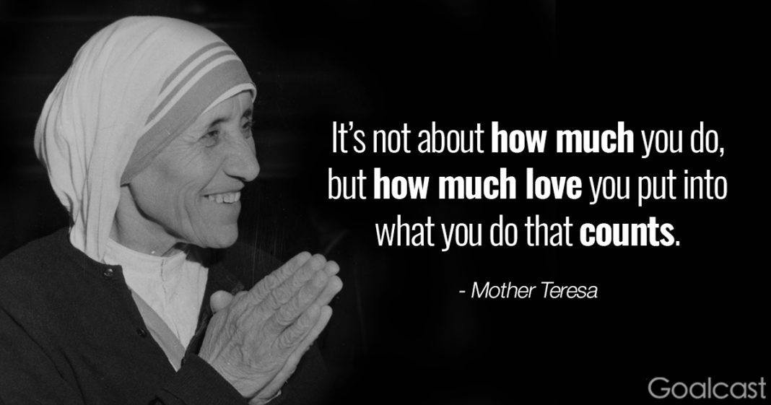
Psychological Factors Important to Health
Love, Positive Health: Compassion and Health
People who are kind and sympathetic to others influence changes in our immune system responses.
Shown film about the life of Mother Teresa as she worked among the sick and dying in India. Immediately after seeing the film on Mother Teresa, all participants showed increased immune system functioning.
Notes:
People who are kind and sympathetic to others influence changes in our immune system responses.
Mother Teresa, a film about the life of Nobel Peace Prize winner Mother Teresa as she worked among the sick and dying in India. Immediately after seeing the film on Mother Teresa, all participants showed increased immune system functioning.

Slide 29

Psychological Factors Important to Health
Love and Positive Health: Altruism
Higher volunteering associated with increased longevity
Helping others related to well-being
Altruism seems to take a person away from their own concerns
Altruism increases social bonds and promotes positive emotions

Slide 30

Psychological Factors Important to Health
Humor and Positive Health
Defense mechanism of humor related to greater personal adjustment and well-being
Good sense of humor helps people recover more quickly from illness
Enhance immune system functioning
Reduce the psychological experience of pain
Notes:
People who scored high on a sense of humor scale also tended to score high on measures of optimism, extraversion, capacity for intimacy, and scored low on measures of neuroticism.

Slide 31
Psychological Factors Important to Health
Humor and Positive Health: Laugh Clubs!
Laugh clubs: People laugh as hard as they can for 15–20 min in groups
Physical act of laughing is healing in itself

Slide 32

Psychological Factors Important to Health
Music and Health
Music can help the healing process
Relaxing sounds lower stress hormones and BP, raise endorphin levels, increase positive moods
Notes:
Music improves health and well-being through the engagement of neurochemical systems involving these four aspects: reward, motivation, and pleasure; stress and arousal; immunity; and social affiliation.

Slide 33
Psychological Factors Important to Health
Music and Health
Music improves health and well-being through the engagement of neurochemical systems involving these four aspects: reward, motivation, and pleasure; stress and arousal; immunity; and social affiliation
Notes:
Music improves health and well-being through the engagement of neurochemical systems involving these four aspects: reward, motivation, and pleasure; stress and arousal; immunity; and social affiliation.

Slide 34
Psychological Factors Important to Health
Emotional Expression and Health: Writing About Our Lives
Act of writing down one’s thoughts about a traumatic event is beneficial
Lower BP, less distress
Greatest improvement in those who had not shared their traumatic event before
Sharing negative emotions is more helpful than focusing only on positive emotions
Those low in expressiveness may have increased anxiety when asked to engage in expressive writing

Slide 35
Psychological Factors Important to Health
Emotional Expression and Health: Writing About Our Lives
Suggestions for using writing to deal with stress and painful memories
Write about an issue current to you
Choose location special and unique, quiet
Ignore spelling, grammar, prose
Write about what happened and feelings about what happened
Plan to keep it private, destroy if you want
Realistic to feel sad after writing, but sadness usually fades; if persists, seek professional counseling

Slide 36
Psychological Factors Important to Health
Emotional Expression and Health: Regrets
Biggest regrets: education, career, romance
Regret actions or inactions
Regrets over actions tend to elicit primarily “hot” emotions (e.g., anger)
Immediately clear
Regrets over inaction generate elicit feelings of wistfulness or despair
Becomes clear over time
Notes:
Life longing: A strong feeling that life is incomplete or imperfect, coupled with a desire for ideal, alternative states and experiences of life. The emotions associated with life longings are often ambivalent, bittersweet, and alert us to both gains and losses in life.

Slide 37
Psychological Factors Important to Health
Emotional Expression and Health: Regrets
Severe regret leads to low subjective well-being
Life longings highly related to studies of regret
A strong feeling that life is incomplete or imperfect, coupled with a desire for ideal, alternative states and experiences of life. The emotions associated with life longings are often ambivalent, bittersweet, and alert us to both gains and losses in life
Notes:
Life longing: A strong feeling that life is incomplete or imperfect, coupled with a desire for ideal, alternative states and experiences of life. The emotions associated with life longings are often ambivalent, bittersweet, and alert us to both gains and losses in life.

Slide 38
Psychological Factors Important to Health
Emotional Expression and Health: Crying: Tears of Hurt
Crying does not benefit everyone
Social and emotionally stable people find relief and feel better after crying
Good cry is not universally helpful

Slide 39


Psychological Factors Important to Health
Emotional Expression and Health: Crying: Tears of Joy
Crying in response to positive events is associated with empathy, compassion, gratitude
More research needed

Slide 40
Psychological Factors Important to Health
Cognition and Thinking: Optimism, Hope, and Control
Cognitive mediation approach is the meaning we bring to a situation
How we think about the event, and the outcomes of events
Cognitive styles are very important for positive coping

Slide 41
Psychological Factors Important to Health
Cognition and Thinking: Optimism, Hope, and Control: Optimism
Generalized expectancy that good things will happen in the future is related to better health outcomes
e.g., recover faster from surgery
Optimists tend to use problem-focused coping and seek social support
A significant factor in better health status
Deal with challenges and stress
Seligman and learned optimism

Slide 42
Psychological Factors Important to Health
Cognition and Thinking: Optimism, Hope, and Control: Perceived Control
Internal LOC related to better outcomes for those with asthma, chronic back pain, and cardiovascular disease
Longitudinal study in UK
Measured LOC at age 10
At age 30, internal LOC in childhood…reduced risk for obesity, fair or poor self-rated health, and psy’l distress

Slide 43
Psychological Factors Important to Health
Cognition and Thinking: Optimism, Hope, and Control: Perceived Control
Internals…more adaptive coping styles and positive health-related behaviors, where control is actually possible
Psychological flexibility: an ability to adapt to changing circumstances

Slide 44

Psychological Factors Important to Health
Cognition and Thinking: Optimism, Hope, and Control: Self-Efficacy
Self-efficacy: belief one has in his/her capability to perform a specific behavior
High in self-efficacy brings more control over health
Problem-solving appraisals: beliefs about one’s problem solving abilities
Associated with psy’l adjustment, better health status, and use of more effective coping skills

Slide 45
Hardiness and Mindfulness Meditation
This section focuses on the individual personality factors that relate to health
Notes:
Combination of three cognitive factors involved with how people interpret life events:
1. A sense of control over their lives.
2. A sense that the stress they were facing presented them with a challenge, rather than a crisis.
3. A sense of commitment to the various areas of their life.

Slide 46
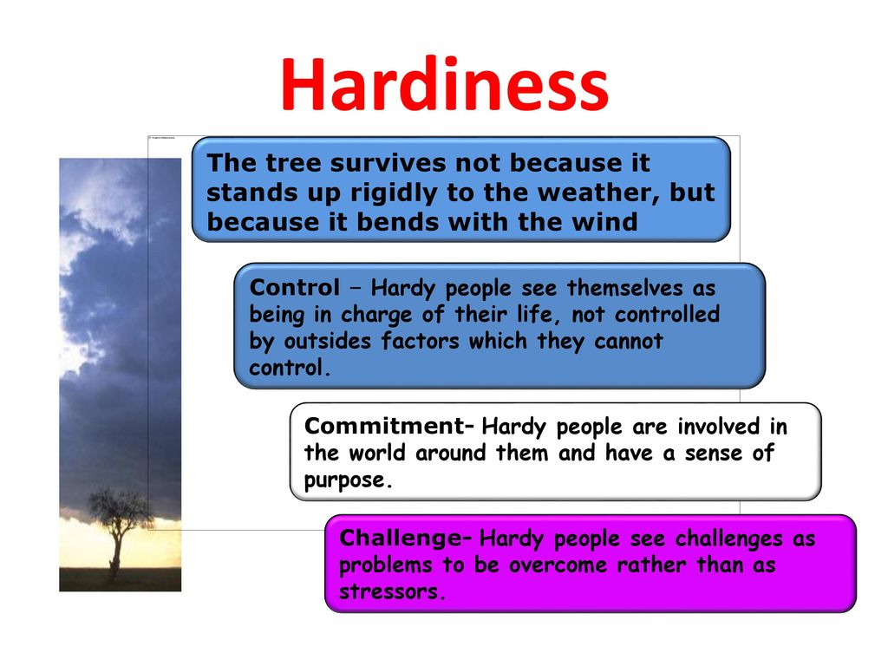
Hardiness and Mindfulness Meditation
Hardiness
Combination of three cognitive factors involved with how people interpret life events
Notes:
Combination of three cognitive factors involved with how people interpret life events:
1. A sense of control over their lives.
2. A sense that the stress they were facing presented them with a challenge, rather than a crisis.
3. A sense of commitment to the various areas of their life.

Slide 47
Hardiness and Mindfulness
Hardiness
Combination of three cognitive factors involved with how people interpret life events
Control: decisional and cognitive control, and greater variety of coping methods
Transformational coping: actively determine the direction change will take
Challenge: challenge rather than crisis
Commitment: meaningfulness, sense of purpose, involvement with others
Notes:
Combination of three cognitive factors involved with how people interpret life events:
1. A sense of control over their lives.
2. A sense that the stress they were facing presented them with a challenge, rather than a crisis.
3. A sense of commitment to the various areas of their life.

Slide 48
Hardiness and Mindfulness Meditation
Mindfulness Meditation
Helps reduce anxiety, stress, worry by promoting cognitive, emotional, and physiological regulatory mechanisms
Help increase immune system functioning
MBSR
Effective adjunctive therapy
Preventative method for ensuring emotional well-being and stability
Notes:
Effective adjunctive therapy: In medical settings, the use of mindfulness has also been an effective adjunctive therapy for such conditions as cancer, insomnia, multiple sclerosis, and has been used to foster greater attention of health professionals to patients’ needs and concerns. The impact of mindfulness meditation may be greater for people who already have higher trait mindfulness.

Slide 49

Positive Aging
Zestful Old Age
Surviving into late adulthood with considerable physical and mental well-being
Peak aging (Erik Erikson) encompasses three broad dimensions
Insight
Wisdom
Playfulness
Notes:
Insight: ”Discernment” and the perception of “heightened reality,” a quality often linked to intuition and nurtured through sensory experience and empathy.
Wisdom: A blend of emotional maturity, sound judgment, and able reasoning.
Playfulness: A vital quality of elder living, and tersely stated that, “The opposite of play is death.”

Slide 50
Positive Aging
Zestful Old Age
Peak aging encompasses three broad dimensions
Insight: ”Discernment” and the perception of “heightened reality,” a quality often linked to intuition and nurtured through sensory experience and empathy.
Wisdom: A blend of emotional maturity, sound judgment, and able reasoning.
Playfulness: A vital quality of elder living, and tersely stated that, “The opposite of play is death.”
Notes:
Insight: ”Discernment” and the perception of “heightened reality,” a quality often linked to intuition and nurtured through sensory experience and empathy.
Wisdom: A blend of emotional maturity, sound judgment, and able reasoning.
Playfulness: A vital quality of elder living, and tersely stated that, “The opposite of play is death.”

Slide 51
Positive Aging
Longevity
Positive health is associated with longevity
Longevity: Positive emotions
More positive and less negative emotions lead to longer life
Boost immunity and longevity in healthy people

Slide 52
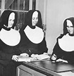
School Sisters of Notre Dame 1932
Sketches were rated in the amount of positive feeling
Most cheerful quarter: 90% alive at age 85, 54% at age 94
Least cheerful quarter: 34% alive at age 85, 11% at age 94

Slide 53
Positive Aging
Longevity: Positive Relationships
Greatest psychological influence on longevity
Positive social ties are a major factor in longevity
Positive relationships are extremely important to female well-being, positive health, and longevity

Slide 54
Positive Aging
Longevity: Competence, Optimism, and Other Positive Beliefs
Optimistic people live longer
People with more positive beliefs about aging bounce back from illness better

Slide 55
Positive Aging
Longevity: The Blue Zones
Areas where people live the longest
People in the blue zones shared nine characteristics summed into:
Move naturally
Keep the right outlook and attitude
Eat wisely
Connect with others
Notes:
Nine characteristics:
1. They remained physically active in their environments.
2. They had a strong sense of purpose or a reason to wake up in the morning.
3. They “downshifted” or found ways to decrease stress every day.
4. They did not overeat and ate their smallest meals in the afternoon and evening.
5. They ate small portions of meat; more fruits and vegetables.
6. They drank alcohol in moderate amounts.
7. They belonged to a faith-based community.
8. They put their families first and experienced satisfying social connections.
9. They shared in supportive social circles and groups of friends.

Slide 56
Positive Coping
A Definition of Positive Coping
Response aimed at diminishing the physical, emotional, and psychological burden
Effective coping should reduce the burden of challenges from stress
Contributes to the relief of longer-term stress
Relief by building resources that inhibit or buffer future challenges
Notes:
Diminishing the physical, emotional, and psychological burden linked to stressful life events and daily hassles.

Slide 57
Positive Coping
The Importance of Daily Hassles
Smaller, daily hassles more detrimental to well-being than significant life events
Daily hassles more likely to impact a person’s current mood and persistent negative mood is likely to affect well-being

Slide 58
Positive Coping
Dimensions of Positive Coping
Positive coping strategies follow two approaches:
Focus on the external environment, physical health, and health behavior
Focus on psychological factors
Attitudes, beliefs, expectations by which we interpret and give meaning to life events
Good stress mgt programs have both of above

Slide 59
Positive Coping
Coping Styles
Coping styles can be grouped into three subtypes
1. Emotion focused (attempt to change emotions)
Emotional processing
understand reaction to stressor
Emotional expression
express emotions related to stress
Notes:
Emotion-Focused: Focus primarily on the emotional reactions to the stressor.
Emotional processing: Understand reaction to a stressor.
Emotional expression: Express emotions related to stress.
Problem-Focused: Focus primarily on the situation or cognitions related to a stressor.
Behavioral: Take action to fix a real-world situation.
Cognitive: Change thinking to fix a problem.
Emotional-avoidance: Avoid, ignore, or deny the reality of either the stressor or the emotional consequences, or both.

Slide 60
Positive Coping
Coping Styles
Coping styles can be grouped into three subtypes
2. Problem focused (attempt to change situation that caused the stress)
Behavioral: take action to fix
Cognitive: change thinking to fix
3. Emotional avoidance (avoidance of the challenge presented by a stressor)
Notes:
Emotion-Focused: Focus primarily on the emotional reactions to the stressor.
Emotional processing: Understand reaction to a stressor.
Emotional expression: Express emotions related to stress.
Problem-Focused: Focus primarily on the situation or cognitions related to a stressor.
Behavioral: Take action to fix a real-world situation.
Cognitive: Change thinking to fix a problem.
Emotional-avoidance: Avoid, ignore, or deny the reality of either the stressor or the emotional consequences, or both.

Slide 61
Summary
Total well-being
Psychological factors influence certain physical processes
Psychological factors impact health, positive emotionality, social support, optimism
Confidence in one’s ability to bounce back from difficulty
Positive coping strategies involve interpretation of our life events

